Slide 1
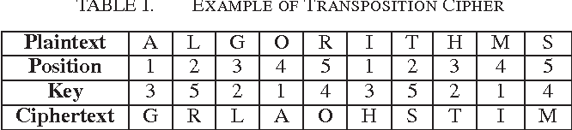
Transposition Cipher
In cryptography, a transposition cipher is a method of encryption by which the positions held by units of plaintext (which are commonly characters or groups of characters) are shifted according to a regular system, so that the ciphertext constitutes a permutation of the plaintext

Slide 2
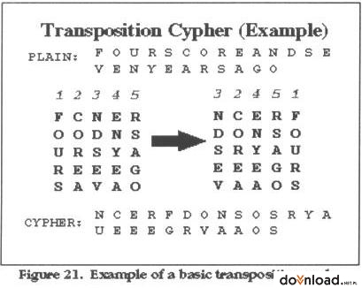

Slide 3
Transposition Techniques
Perform permutation over the plain text alphabets
Plain Text- attack postponed until twomxy z
Key- 3421567
Position: 1 2 3 4 5 6 7
Plaintext: a t t a c k p
o s t p o n e
d u n t I l t
w o a m x y z
Ciphertext: TTNAAPTMTSUOAODWCOIXKNLYPETZ

Slide 4
Type of Transposition Technique
Rail Fence Technique
Columnar Transposition Technique
Vernam Cipher(One-Time Pad)

Slide 5
Rail-fence Cipher
The railfence cipher is a very simple, easy to crack cipher
It is a transposition cipher that follows a simple rule for mixing up the characters in the plaintext to form the ciphertext
Writing plain text as sequence of diagonals and then reading it row-by-row to produce cipher text, Key value defined the rows
The key for the railfence cipher is just the number of rails

Slide 6
Rail Fence Technique
Example – Plain Text- COME AT HOME , where key value KEY=5
Cipher Text- CMOOEMHETA
 | 0 | 1 | 2 | 3 | 4 | 5 | 6 | 7 | 8 | 9
0 | C |  |  |  |  |  |  |  | M
1 |  | O |  |  |  |  |  | O |  | E
2 |  |  | M |  |  |  | H
3 |  |  |  | E |  | T
4 |  |  |  |  | A

Slide 7
Rail Fence Technique
Decryption of Cipher Text- CMOOEMHETA , KEY=5
C M OOEMHETA
 | 0 | 1 | 2 | 3 | 4 | 5 | 6 | 7 | 8 | 9
0 | C |  |  |  |  |  |  |  | M
1 |  | - |  |  |  |  |  | - |  | -
2 |  |  | - |  |  |  | -
3 |  |  |  | - |  | -
4 |  |  |  |  | -

Slide 8
Rail Fence Technique
Decryption of Cipher Text- CMOOEMHETA , KEY=5
C M O O E MHETA
 | 0 | 1 | 2 | 3 | 4 | 5 | 6 | 7 | 8 | 9
0 | C |  |  |  |  |  |  |  | M
1 |  | O |  |  |  |  |  | O |  | E
2 |  |  | - |  |  |  | -
3 |  |  |  | - |  | -
4 |  |  |  |  | -

Slide 9
Rail Fence Technique
Decryption of Cipher Text- CMOOEMHETA , KEY=5
C M O O E M H ETA
 | 0 | 1 | 2 | 3 | 4 | 5 | 6 | 7 | 8 | 9
0 | C |  |  |  |  |  |  |  | M
1 |  | O |  |  |  |  |  | O |  | E
2 |  |  | M |  |  |  | H
3 |  |  |  | - |  | -
4 |  |  |  |  | -

Slide 10
Rail Fence Technique
Decryption of Cipher Text- CMOOEMHETA , KEY=5
C M O O E M H E T A
 | 0 | 1 | 2 | 3 | 4 | 5 | 6 | 7 | 8 | 9
0 | C |  |  |  |  |  |  |  | M
1 |  | O |  |  |  |  |  | O |  | E
2 |  |  | M |  |  |  | H
3 |  |  |  | E |  | T
4 |  |  |  |  | -

Slide 11
Rail Fence Technique
Decryption of Cipher Text- CMOOEMHETA , KEY=5
C M O O E M H E T A
Read Column-by-column
Plain Text- COME AT HOME
 | 0 | 1 | 2 | 3 | 4 | 5 | 6 | 7 | 8 | 9
0 | C |  |  |  |  |  |  |  | M
1 |  | O |  |  |  |  |  | O |  | E
2 |  |  | M |  |  |  | H
3 |  |  |  | E |  | T
4 |  |  |  |  | A

Slide 12
Plaintext
defend the east wall of the castle
We write it out in a special way on a number of rails (the key here is 3)

Slide 13
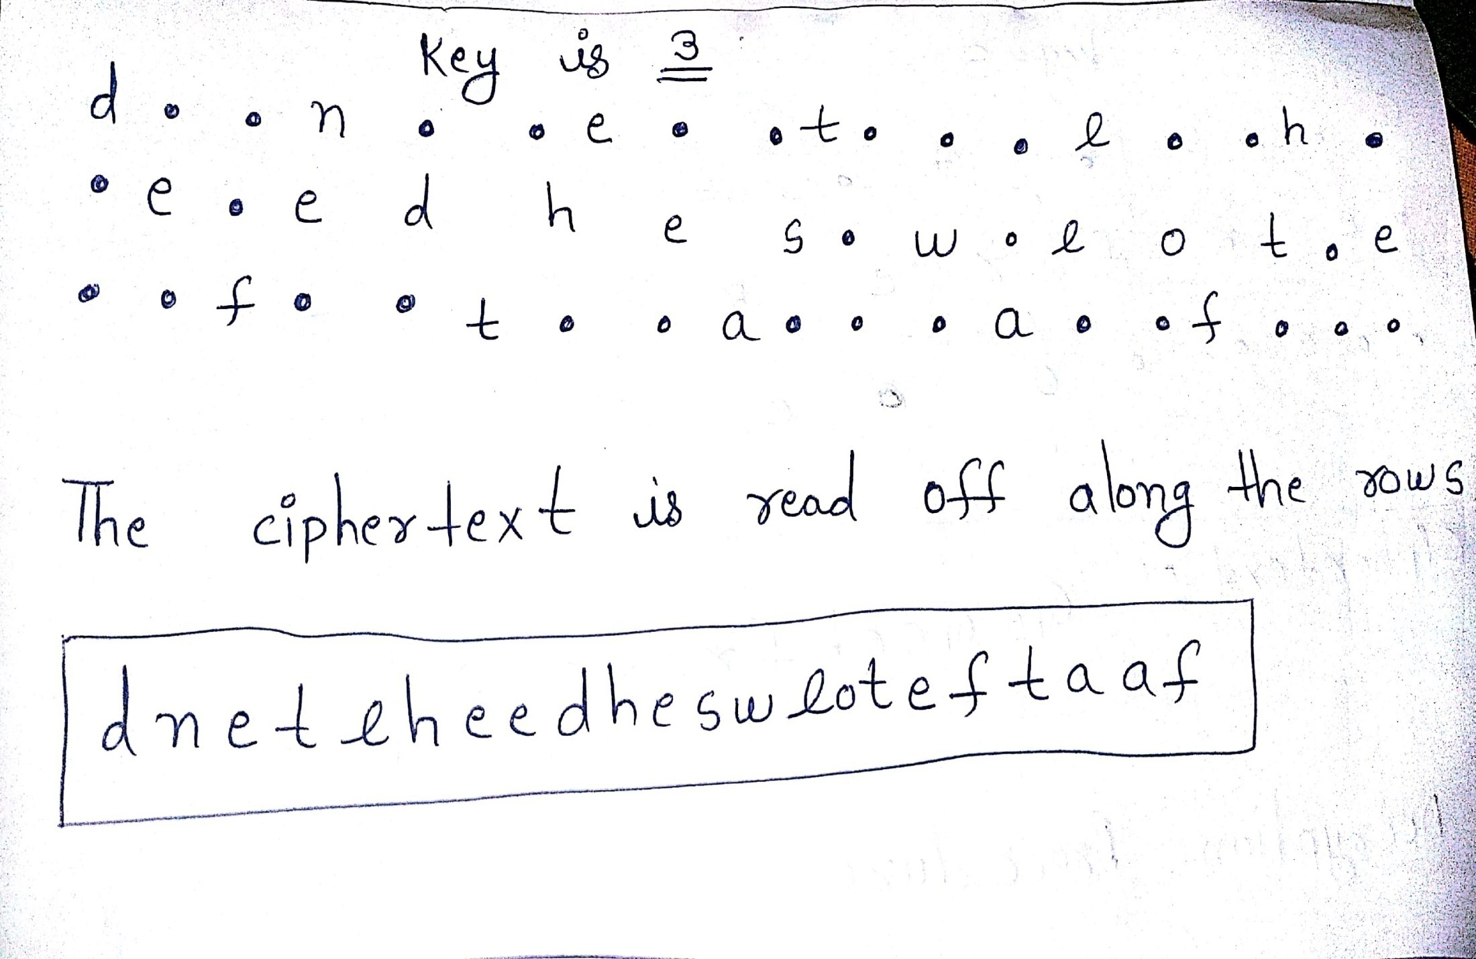

Slide 14
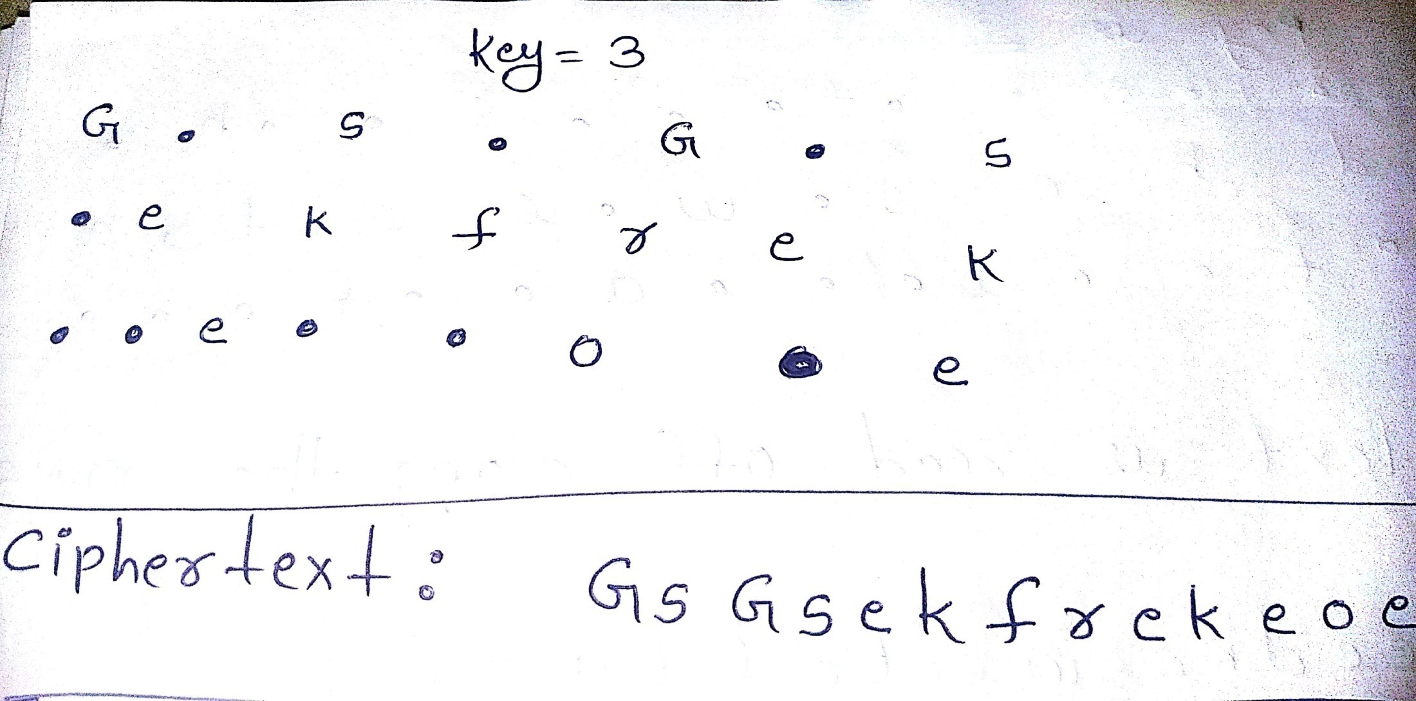

Slide 15
Columnar Transposition Technique
Arrange plaintext as a sequence of rows of rectangle that are read in columns randomly
Write the plain text message row-by-row in a pre-defined rectangle
Read message column-by-column, it can be any random order
Obtained message is cipher text message
Plain Text- COME HOME TOMORROW Let column size-6
Key(column random order)- 461253
Cipher Text- EOWOOCMROERHMMTO
1 | 2 | 3 | 4 | 5 | 6
C | O | M | E | H | O
M | E | T | O | M | O
R | R | O | W

Slide 16
Vernam Cipher
Uses a one-time pad, which is discarded after a single use
Suitable only for short messages
Implemented using a random set of non-repeating characters as input cipher text
Once an input cipher text for transposition is used, it is never used again for any other message(hence the name one-time)
Length of input cipher text is equal to the length of original plain text
Vernam Cipher Algorithm
Each alphabet assign a number A=0,B=1,C=2,….,Z=25
Do the same for each character of the input cipher text
Add each number corresponding to plain text alphabet to corresponding input cipher text alphabet number
If sum is grater than 26, subtract 26 from it
Translate each number of the sum back to the corresponding alphabet. This gives the output cipher text

Slide 17
Vernam Cipher
Let apply Vernam Cipher to plain text message HOW ARE YOU using a one-time pad NCBTZQARX
Plain Text:
H O W A R E Y O U
7 14 22 0 17 4 24 14 20
+
13 2 1 19 25 16 0 17 23
N C B T Z Q A R X
-------------------------------------------------------------------------------------------
20 16 23 19 42 20 24 31 43
Subtract 26, if >25
20 16 23 19 16 20 24 5 17
Cipher Text:
U Q X T Q U Y F R

Slide 18
Stream and Block Cipher

Slide 19
Block Cipher and Stream Cipher are the methods used for converting the plain text into cipher text directly and belong to the family of symmetric key ciphers

Slide 20
Stream Cipher Stream cipher encrypts and decrypts the text by taking the one byte of the text at a time Byte by Byte conversion of plaintext to cipher text is known as stream cipher

Slide 21


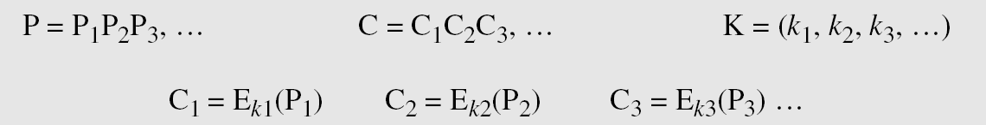
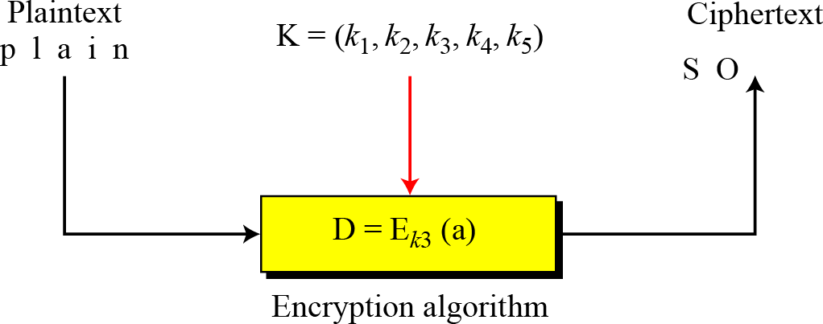
Stream Ciphers
Call the plaintext stream P, the ciphertext stream C, and the key stream K.
Figure Stream cipher

Slide 22


Example
Example 1
Additive ciphers can be categorized as stream ciphers in which the key stream is the repeated value of the key. In other words, the key stream is considered as a predetermined stream of keys or K = (k, k, …, k). In this cipher, however, each character in the ciphertext depends only on the corresponding character in the plaintext, because the key stream is generated independently.
Example 2
Vigenere ciphers are also stream ciphers according to the definition. In this case, the key stream is a repetition of m values, where m is the size of the keyword. In other words,

Slide 23
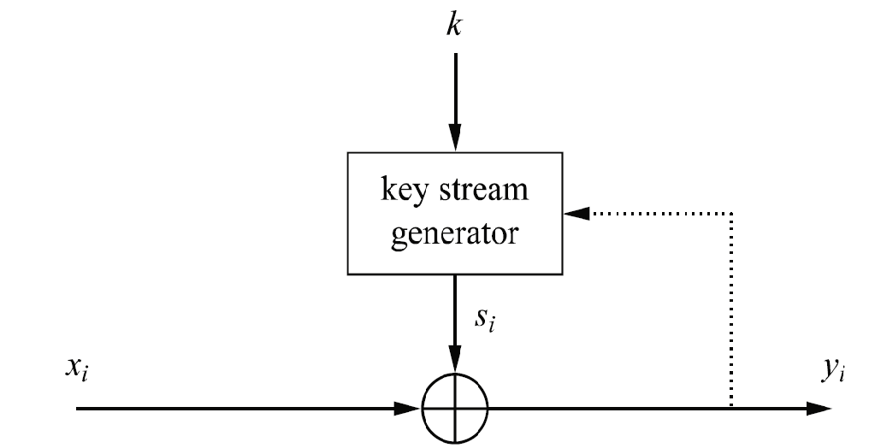
Stream Cipher
Stream cipher encrypt bits individually, achieved by adding a bit from a key stream to a plaintext bit
Synchronous Stream Cipher-Key stream depends only on the key
Asynchronous Stream Cipher-Key stream depends on cipher text
Dotted line in fig. shows stream ciphers is asynchronous ones

Slide 24
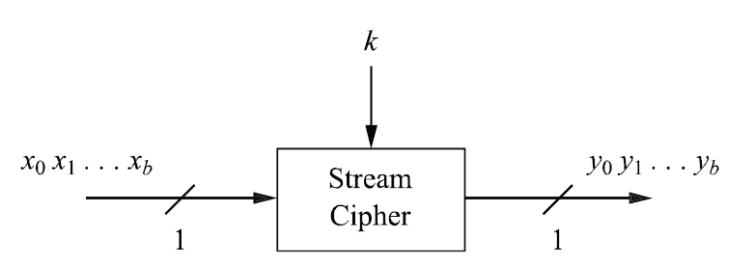
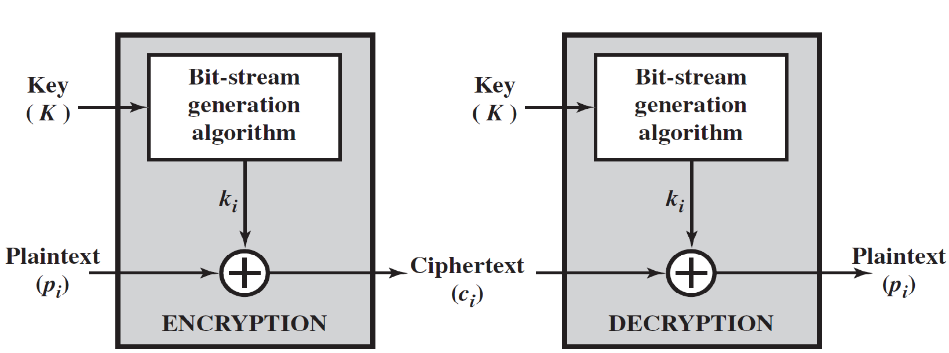
Stream Cipher

Slide 25
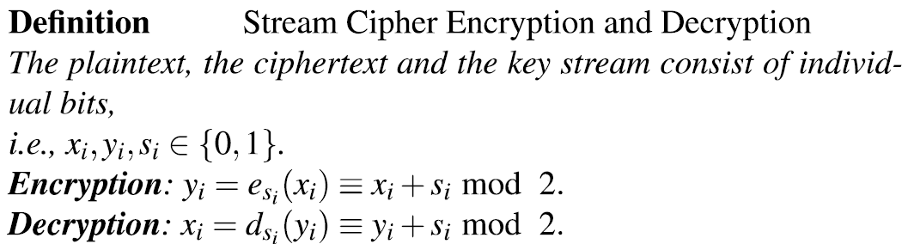
Encryption and Decryption with Stream Cipher
Encryption and decryption functions both are used addition modulo 2
Why are Encryption and Decryption the Same function?
Because decryption function produces plaintext bit x_{i}
d_{si} (y_{i})= y_{i}+s_{i} mod 2
=(x_{i}+s_{i})+s_{i} mod 2
=x_{i}+s_{i}+s_{i} mod 2
=x_{i}+2s_{i} mod 2
=x_{i}+0 mod 2
=x_{i} mod 2

Slide 26
Encryption and Decryption with Stream Cipher
Why is modulo 2 addition a good encryption function
If we do arithmetic modulo 2, only possible values are 0 and 1
Modulo 2 addition is equivalent to the XOR operation
Example-
If the next byte generated by the generator is 01101100 and the plaintext byte is 11001100 then the resulting cipher text byte is
Plaintext 11001100
Key Stream 01101100
-------------
10100000 Ciphertext
Decryption
Ciphertext 10100000
Key stream 01101100
-----------------
11001100 Plaintext

Slide 27
Block Ciphers
We will group some plaintext and we form a block and at a time each block will be process
Block cipher encrypts and decrypts a block of the text at a time
Block ciphers break messages into fixed length blocks, and encrypt each block using the same key
The Data Encryption Standard (DES) is an example of a block cipher, where blocks of 64 bits are encrypted using a 56-bit key.

Slide 28

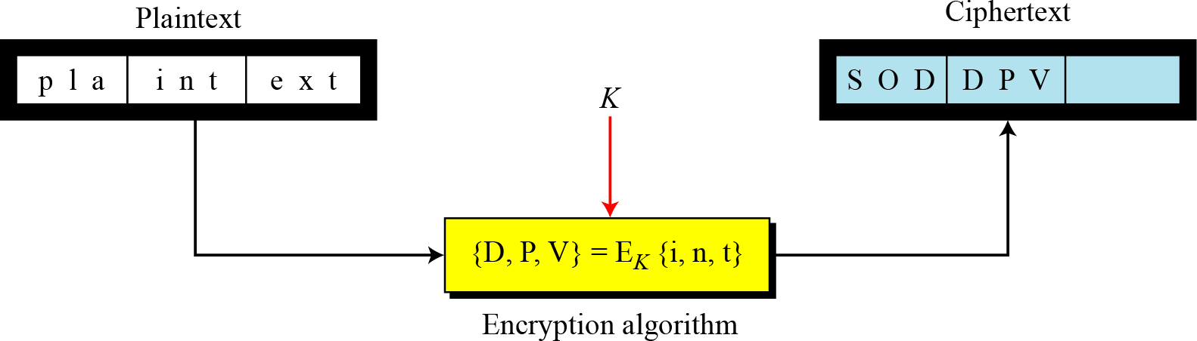
Block Ciphers
In a block cipher, a group of plaintext symbols of size m (m > 1) are encrypted together creating a group of ciphertext of the same size. A single key is used to encrypt the whole block even if the key is made of multiple values. Figure 1 shows the concept of a block cipher.
Figure 1 Block cipher

Slide 29
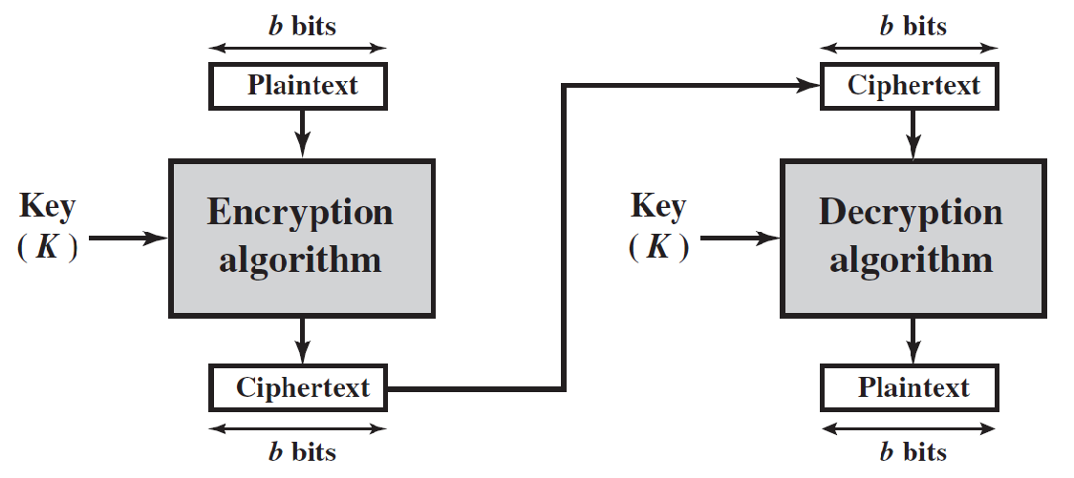
Block Cipher
A block of plaintext is used to produce a ciphertext block of equal length
A block size of 64 or 128 bits is used
DES, AES, Tripe DES perform Block cipher encryption and decryption

Slide 30

Example
Example 1
Playfair ciphers are block ciphers. The size of the block is m = 2. Two characters are encrypted together.
Example 2
Hill ciphers are block ciphers. A block of plaintext, of size 2 or more is encrypted together using a single key (a matrix). In these ciphers, the value of each character in the ciphertext depends on all the values of the characters in the plaintext. Although the key is made of m × m values, it is considered as a single key.

Slide 31
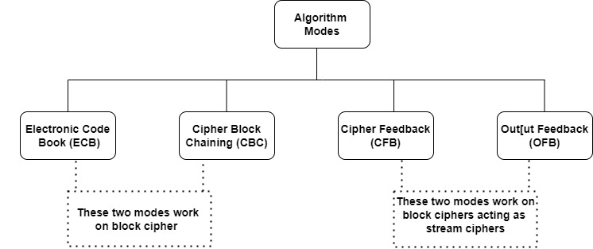
Block Cipher
To encrypt more than one single 8-byte or 16-byte block of plaintext
When encrypting an e-mail or a computer file block cipher used several algorithm modes

Slide 32
Electronic Code Book (ECB) Mode
Text message divided into blocks of 64 bits. Each such block then encrypted independently of the other blocks, padding used if plaintext is not multiple of block size
Similarly at receiver end incoming data is divided into 64-bit blocks and decrypted with same key
Single key use for encrypting and decrypting all the blocks of a message
Suitable only for encrypting small messages
Usages for transmitting a single value in a secure fashion(like password or key used for encryption
Security issues-
Plaintext patterns are not hidden
Input to the block cipher is same as the plaintext and is not randomized
Plaintext is easy to manipulate, blocks of text can be removed, repeated or exchanged

Slide 33
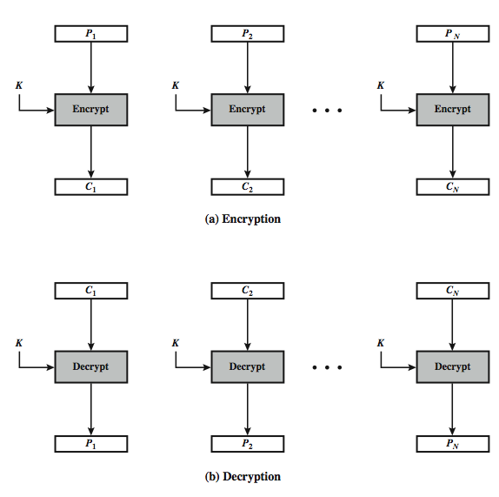
Electronic Codebook Book (ECB)
Notes:
33
Stallings Figure 6.3 illustrates the Electronic Codebook (ECB) Mode.

Slide 34
Cipher Block Chaining (CBC) Mode
Ensure two identical plain text blocks yield totally different cipher text blocks in the output
Adds a feedback mechanism to a block cipher
Encryption of previous block fed back into encryption of current block
Initialization vector (IV) used only in first plain text block
Initialization vector used to make each message unique
Value of initialization vector generated randomly
Use Initial Vector (IV) to start process
Ci = EK(Pi XOR Ci-1)
C-1 = IV
The cipher text of first block will be given input as the second block
Each previous cipher block is chained with current plaintext block, hence name
Same key used to encrypt all plain text blocks
Usages in authentication
Security issues-
Same key can be used for encrypting multiple messages
Size of cipher text more than plain text size by one block
Pre-processing is not possible

Slide 35
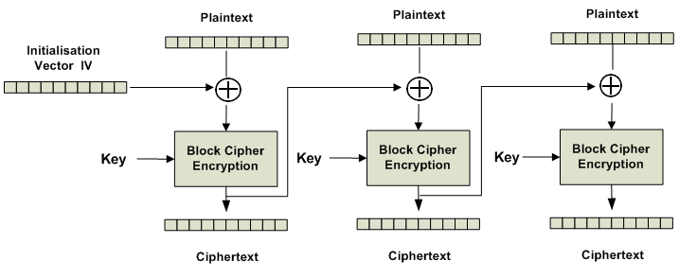
Cipher Block Chaining (CBC) Mode

Slide 36
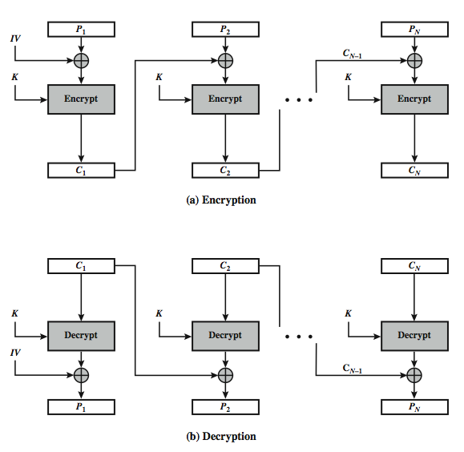
Cipher Block Chaining (CBC)
Notes:
36
Stallings Figure 6.4 illustrates the Cipher Block Chaining (CBC) Mode.

Slide 37
Cipher FeedBack (CFB)
Message is treated as a stream of bits
Added to the output of the block cipher
Result is feed back for next stage (hence name)
Standard allows any number of bits (1,8, 64 or 128 etc) to be feed back
denoted CFB-1, CFB-8, CFB-64, CFB-128, etc.
Most efficient to use all bits in block (64 or 128)
C_{i} = P_{i} XOR E_{K}(C_{i-1})
C₋₁ = IV
Uses: stream data encryption, authentication
Notes:
37
Cipher feedback (CFB) mode is one alternative. As with CBC, the units of plaintext are chained together, so that the ciphertext of any plaintext unit is a function of all the preceding plaintext. In this case, rather than units of b bits, the plaintext is divided into segments of s bits. The input to the encryption function is a b-bit shift register that is initially set to some initialization vector (IV). The leftmost (most significant) s bits of the output of the encryption function are XORed with the first segment of plaintext P1 to produce the first unit of ciphertext C1, which is then transmitted. In addition, the contents of the shift register are shifted left by s bits and C1 is placed in the rightmost (least significant) s bits of the shift register. This process continues until all plaintext units have been encrypted. For decryption, the same scheme is used, except that the received ciphertext unit is XORed with the output of the encryption function to produce the plaintext unit. Note that it is the encryption function that is used, not the decryption function.
As originally defined, CFB was to "consume" as much of the "random" output as needed for each message unit (bit/byte) before "bumping" bits out of the buffer and re-encrypting. This is wasteful though, and slows the encryption down as more encryptions are needed. An alternate way to think of it is to generate a block of "random" bits, consume them as message bits/bytes arrive, and when they're used up, only then feed a full block of ciphertext back. This is CFB-64 or CFB-128 mode (depending on the block size of the cipher used eg DES or AES respectively). CFB is the usual choice for quantities of stream oriented data, and for authentication use.

Slide 38
In this mode the cipher is given as feedback to the next block of encryption with some new specifications
first an initial vector IV is used for first encryption and output bits are divided as set of s and b-s bits the left hand side s bits are selected and are applied an XOR operation with plaintext bits
The result given as input to a shift register and the process continues

Slide 39
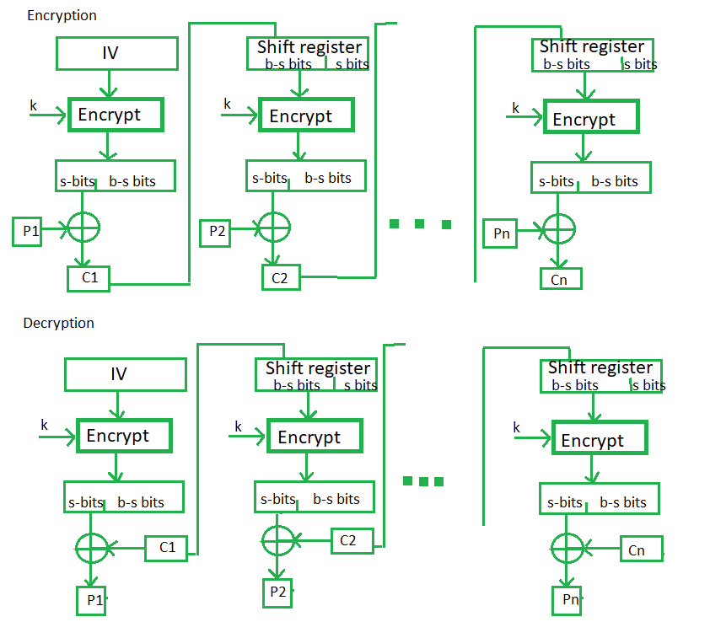
Discard the left most s bits
Select left most s bits

Slide 40
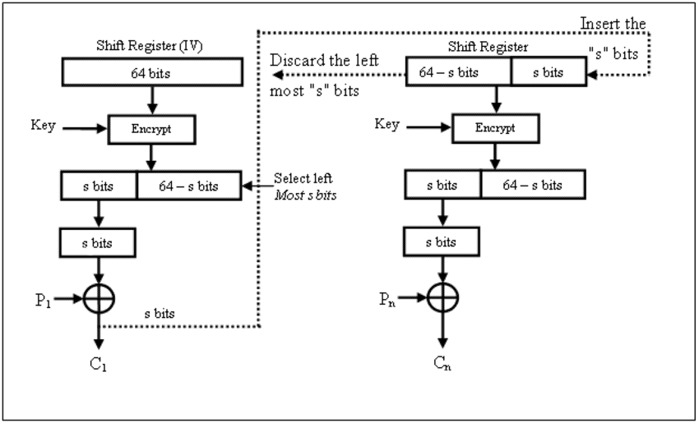
Select
Discard
Select
Discard
S Bits
S Bits

Slide 41
Output FeedBack (OFB)
Message is treated as a stream of bits
Output of cipher is added to message
Output is then feed back (hence name)
O_{i} = E_{K}(O_{i-1})
C_{i} = P_{i} XOR O_{i}
O₋₁ = IV
Feedback is independent of message
Can be computed in advance
Uses: stream encryption
Notes:
41
An alternative to CFB is OFB. Here the generation of the "random" bits is independent of the message being encrypted. The output feedback (OFB) mode is similar in structure to that of CFB, except that the output of the encryption function is fed back to the shift register in OFB, whereas in CFB the ciphertext unit is fed back to the shift register. The other difference is that the OFB mode operates on full blocks of plaintext and ciphertext, not on an s-bit subset. The advantage is that firstly, they can be computed in advance, which is good for bursty traffic, and secondly, any bit error only affects a single bit. Thus this is good for noisy links (eg satellite TV transmissions etc).

Slide 42
The output feedback mode follows nearly same process as the Cipher Feedback mode except that it sends the encrypted output as feedback instead of the actual cipher which is XOR output
In this output feedback mode, all bits of the block are send instead of sending selected s bits.

Slide 43
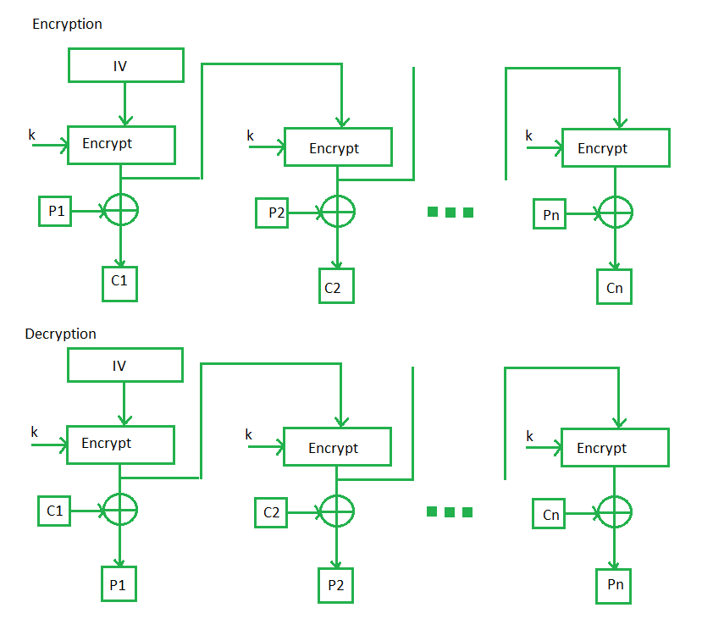

Slide 44
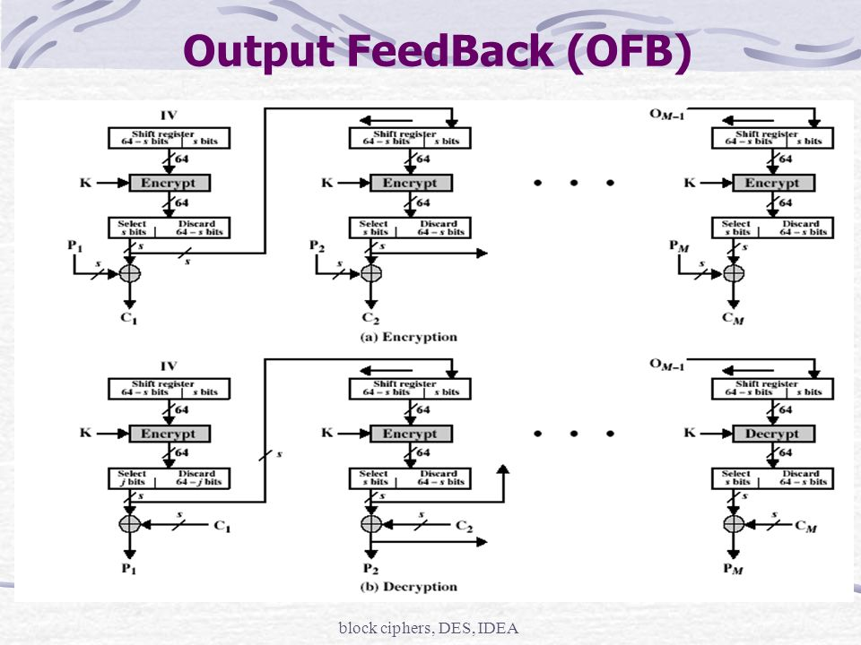
Discard left most s bits

Slide 45
Counter (CTR)
Similar to OFB but encrypts counter value rather than any feedback value
O_{i} = E_{K}(Counter)
C_{i} = P_{i} XOR O_{i}
Must have a different key & counter value for every plaintext block (never reused)
Notes:
45
The Counter (CTR) mode is a variant of OFB, but which encrypts a counter value (hence name). Although it was proposed many years before, it has only recently been standardized for use with AES along with the other existing 4 modes. It is being used with applications in ATM (asynchronous transfer mode) network security and IPSec (IP security). A counter, equal to the plaintext block size is used. The only requirement stated in SP 800-38A is that the counter value must be different for each plaintext block that is encrypted. Typically the counter is initialized to some value and then incremented by 1 for each subsequent block. As with the OFB mode, the initial counter value must be a nonce; be different for all of the messages encrypted using the same key. Further, all counter values across all messages must be unique. If, contrary to this requirement, a counter value is used multiple times, then the confidentiality of all of the plaintext blocks corresponding to that counter value may be compromised.

Slide 46
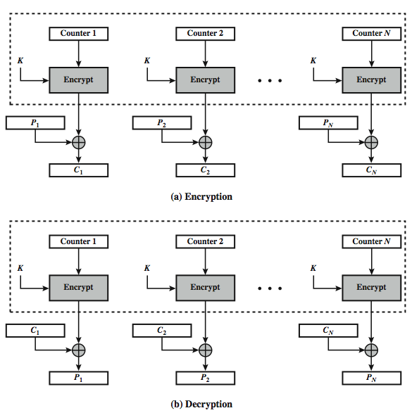
Counter (CTR)
Decrypt
Decrypt
Decrypt
Notes:
46
Stallings Figure 6.7 illustrates the Counter (CTR) Mode.

Slide 47
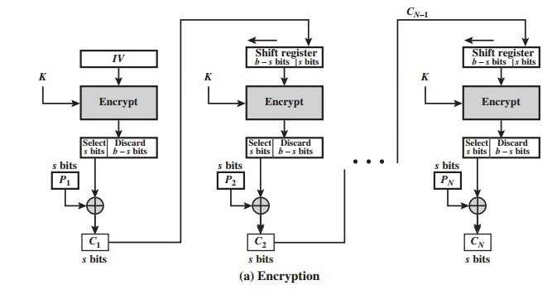
Cipher Feedback (CFB) Mode
Encrypts data in units that are smaller (8 bits size of characters) than a defined block size(64 bits)
K bits of randomized cipher text from previous step and K bits plain text of next step are XORed together
Used in authentication and transmitting encrypted stream of data

Slide 48
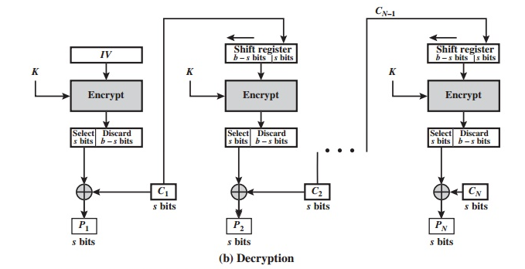
Cipher Feedback (CFB) Mode

Slide 49
Output Feedback (OFB) Mode
Similar to CFB, but OFB output of initial vector (IV) encryption process fed into next stage of encryption process
If errors in individual bots, they remain errors in individual bits and do not corrupt whole message
Used for transmitting encrypted stream of data
Avoid error propagation
Input to block cipher randomized
Security Issue
Plain text easy to manipulate
Altering cipher text alters plain text directly

Slide 50
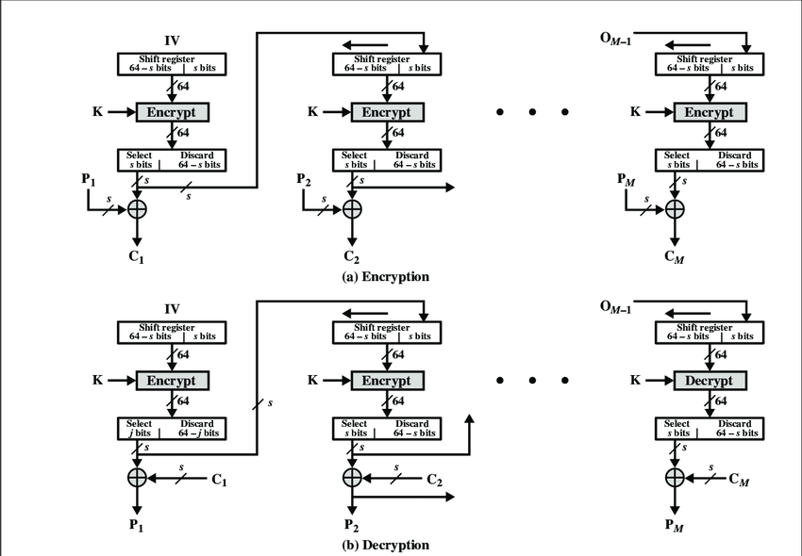
Output Feedback (OFB) Mode

Slide 51
Counter
In counter mode there is no feedback
Pseudo randomness in key streams achieved using a counter
N bit counter is initialized to predetermined value if initiation vector and incremented based on predefined rule (mod 2^{n})
To provide better randomness, increment value can depend on block numbers to be incremented
Both encryption and decryption can be performed fully in parallel on multiple blocks
Provides true random access to cipher text blocks

Slide 52
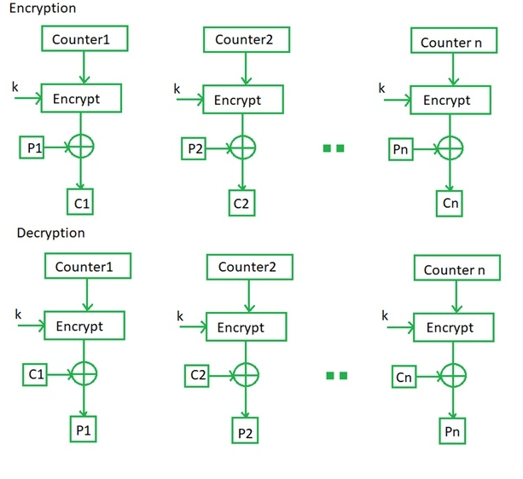
Counter

